Slide 1
Impact of Science Conference the roundtable on:
Open Science
23rd June, 2021

Slide 2
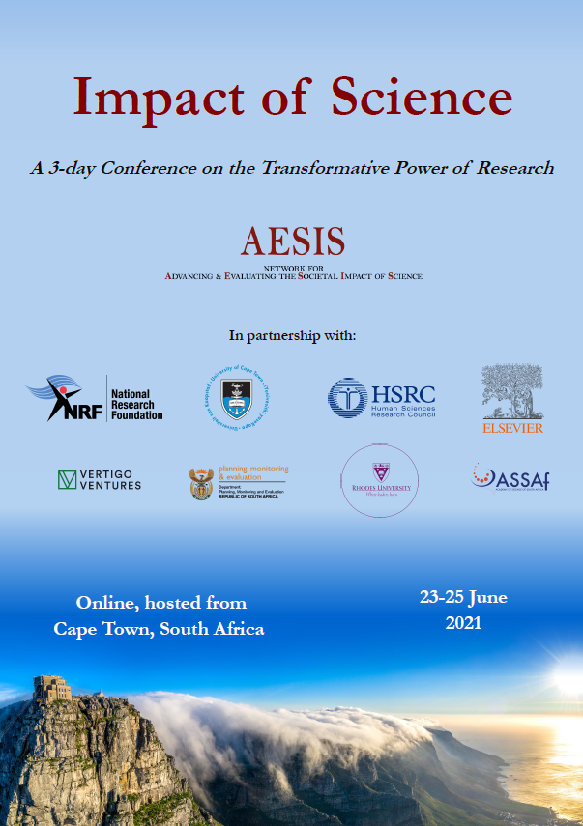
Impact of Science
23-25 June, 2021
Paul Wouters: Dean of Social Sciences & former Director of CWTS, Leiden University, the Netherlands
Sue Harrison: Deputy Vice-Chancellor for Research and Internationalisation at University of Cape Town, South Africa
Overview of the Speakers
#IOS21

Slide 3
Impact of Science
23-25 June, 2021
Paul Wouters
Dean of Social Sciences & former Director of CWTS, Leiden University, the Netherlands
#IOS21

Slide 4
Frameworks for Fostering Open Knowledge Practices in Science and Scholarship
Paul Wouters
Impact of Science 2021 AESIS
23 June 2021
Notes:
introduce

Slide 5
Definition of open science
In May 2016, the Competitiveness Council adopted conclusions on ‘The transition towards an Open Science system’ where it acknowledges that “Open Science has the potential to increase the quality, impact and benefits of science and to accelerate advancement of knowledge by making it more reliable, more efficient and accurate, better understandable by society and responsive to societal challenges, and has the potential to enable growth and innovation through reuse of scientific results by all stakeholders at all levels of society, and ultimately contribute to growth and competitiveness of Europe”.

Slide 6
Key considerations
Open knowledge practices are the key issue (not open artefacts or outputs)
Open science is very diverse
Generic “OS indicators” are fundamentally in contradiction to the very concept of open science
Open science is very dynamic: tools come and go
Indicators are only useful if put in the right context and closely connected to the practices
Existing/developing metrics are partial and only relevant in a specific context

Slide 7
Recommendations EU Expert Group
Funding agencies, research performing organizations, publishers, and policy makers work together to prioritize a four-fold approach to open science:
creating novel infrastructures to enable effective and efficient knowledge sharing at all points of the research cycle.
building open knowledge practice capabilities in all scholarly communities.
investing in best practices and exemplary initiatives in knowledge sharing which are transformative in their field.
including these open knowledge practices in the reward and incentive systems at national and European levels and removing performance indicators that act as barriers to engagement.

Slide 8
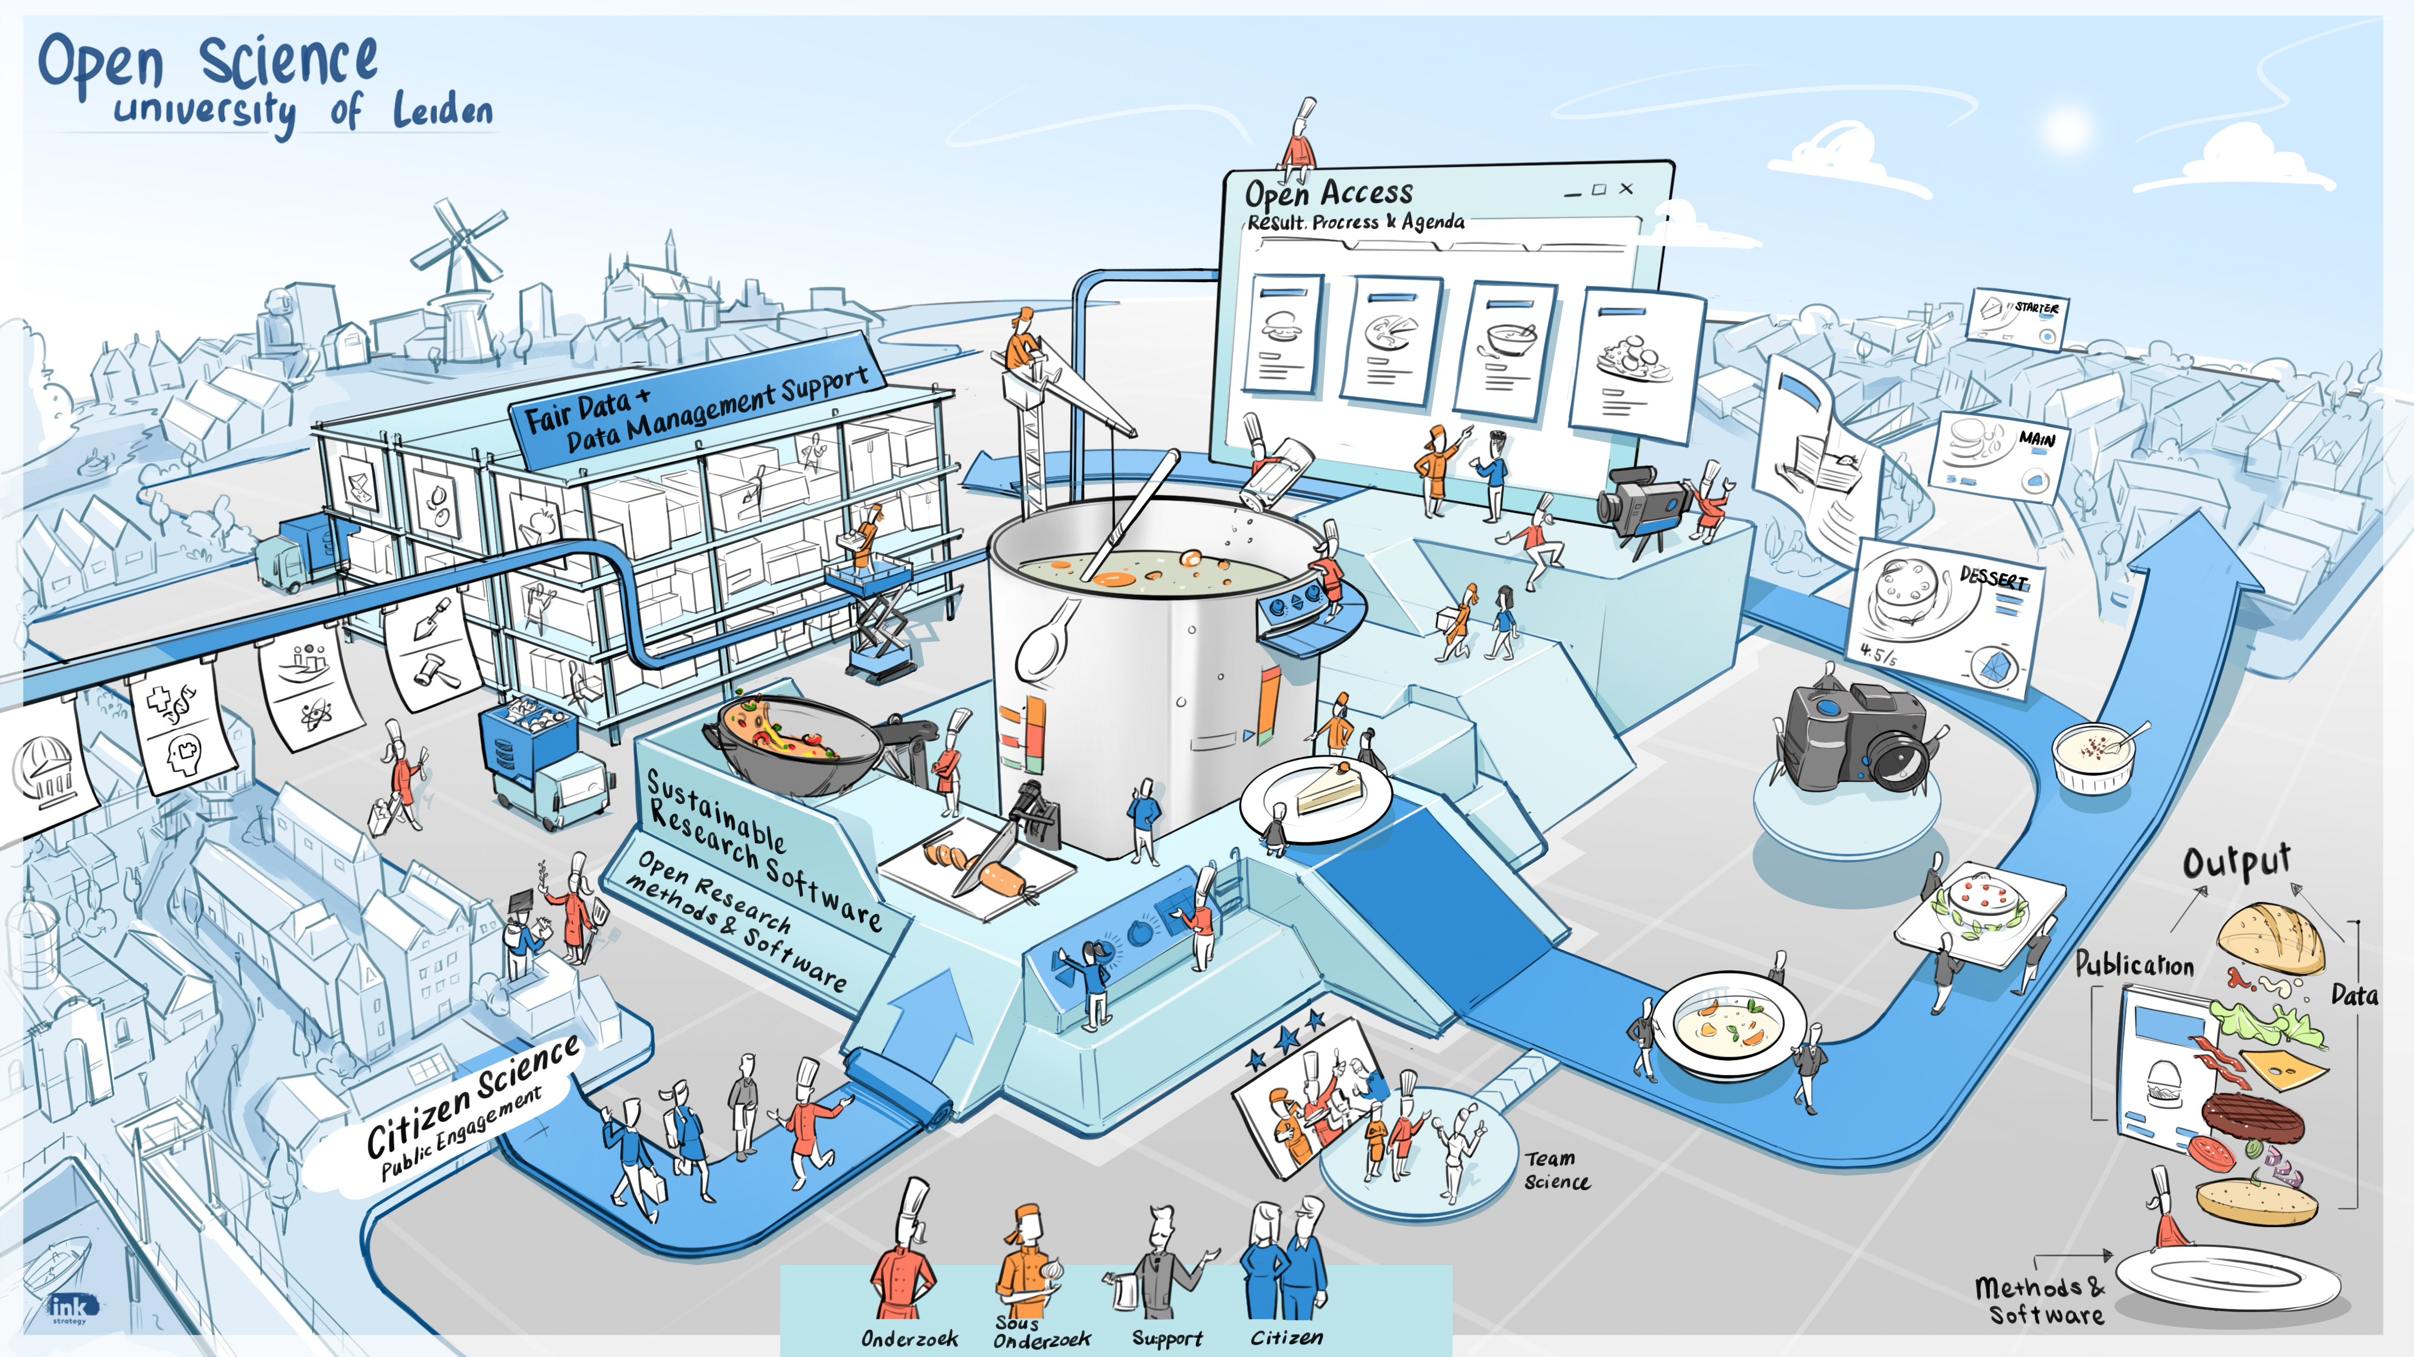
Towards Excellent Research for Resilient Societies Open Science @ Leiden University
Open Science is a transformation of the way we create and circulate knowledge
Why is a change necessary?
Developing open knowledge practices: the five key areas
5
How are we going to do this?
Plan of approach
1
2
4
7
3
Our ambitions
6
Members of the Open Science Working Group
Best practices
8
Name speaker | Place

Slide 9
Impact of Science
23-25 June, 2021
Sue Harrison
Deputy Vice-Chancellor for Research and Internationalisation at University of Cape Town, South Africa
#IOS21

Slide 10
OPEN SCIENCE
Impact of Science 2021
PROF SUE HARRISON

Slide 11
WHY OPEN SCIENCE?
Visible
Discoverable
Equitable
Re-usable
Open repositories form a core backbone
Our mindset does the rest….

Slide 12
WHY OPEN SCIENCE?
http://www.researchsupport.uct.ac.za/why-open-science

Slide 13
ATTAINING OPEN SCIENCE PRINCIPLES
Whose data is it anyway?
Value-driven
Co-creation
Power- balance
Equity Partnership
Crossing disciplines. Crossing constituencies.

Slide 14
Impact of Science
23-25 June, 2021
Thank you
#IOS21

